Slide 1

Notes:
A couple of years ago, I found myself at Spicer landfill in Porirua, watching waste being compacted.
I was there because I’d tracked a nearly new food mixer from the local Kmart store. I’d created a minor fault in the mixer, hid a GPS tracker in it and returned it to the store for a refund. Then I watched what happened.
It was no surprise to see the mixer hit the bins around the back of Kmart – I’d asked if my old mixer would get repaired, and the assistant looked confused.
But I was still shocked to see the tracker move to the bins withing a couple of hours, then a day later make it’s final journey to the rubbish pile.

Slide 2
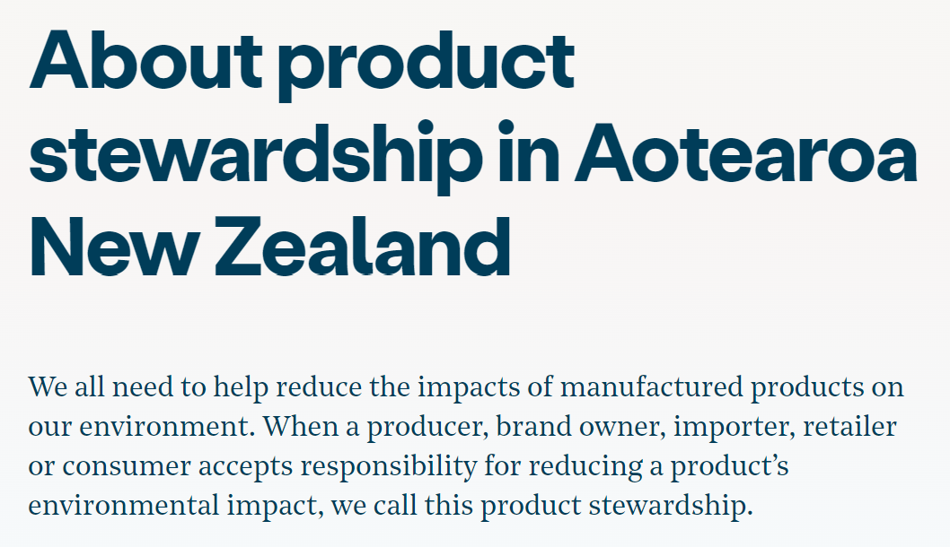
Notes:
Around the same time, I was part of the working group tasked with developing a mandatory electrical and electronic product stewardship scheme.
The scheme would impose a fee on every product sold into our market, to be used to pay for systems that keep those products out of landfill.
I got to thinking… how did we get ourselves into this?

Slide 3

Notes:
To try to understand, I went back over a century, to the dawn of mass manufacturing. And the dawn of product obsolescence.
This is the Centennial Light – it’s been burning continuously for 123 years in Livermore Fire Station in California. It’s often held up as an example of planned obsolescence – of manufacturers intentionally reducing product life.
That’s because this bulb was manufactured before the Phoebus Cartel arrived on the lightbulb scene.

Slide 4
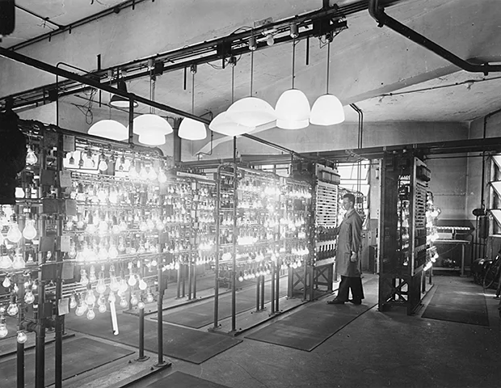
PHOEBUS CARTEL
1924 to 1930-ish
Notes:
The early 20th Century was a difficult time for lightbulb manufacturers. The explosion of electricity use meant there was tremendous opportunity. But with that came innovation and industry challengers. The established manufacturers experienced wild swings in sales, and wanted stability.
The Phoebus cartel was a group of all the major bulb manufacturers, who covered the global market. It included names you’ll know like Osram, Philips and General Electric.
Of course, they didn’t call themselves a cartel. They all signed up to the “Convention for the Development and Progress of the International Incandescent Electric Lamp Industry.”
But like any good cartel, their goal was to control the market for their own gain. They split up the worldwide lightbulb market, assigning manufacturers and production quotas to each zone.
But that wasn’t enough for them

Slide 5
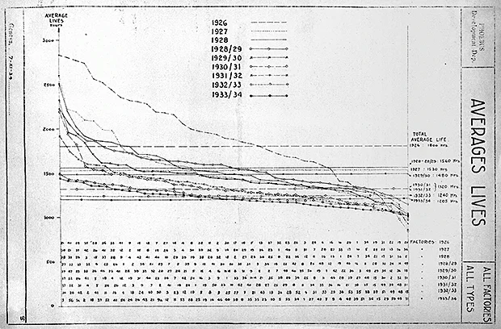
1924: 2500 hours
1926: 1800 hours
1933: 1205 hours
Osram document, Municipal Archive of Berlin
Notes:
Prior to the cartel forming, household lightbulbs typically lasted up to 2500 hours. Manufacturers were proud of their durability.
But the cartel wanted them to fail faster – it aimed for a life not more than 1000 hours.
That wasn’t easy, it wasn’t as simple as just making a shoddy product. So the cartel invested in research and development to engineer bulbs that failed consistently.
It even set up a “quality” testing centre to ensure bulbs coming from its hundreds of global factories achieved the target (previous slide). And it fined factories that fell short (or is that fell long?)
Cartel documents show that, by 1933, the average life of a bulb coming from one of its factories was 1205 hours, and none of them produced bulbs that burned for more than 1500 hours. The cartel proudly marketed its bulbs “guaranteed to last 1000 hours”.
The members were rewarded with more sales and more profit. While lightbulb consumers lost choice – the ability to choose a longer lasting bulb.
The Phoebus Cartel introduced the idea of planned obsolescence, by intentionally making a product physically fail sooner than it should.
Now, let’s jump forward a century.

Slide 6
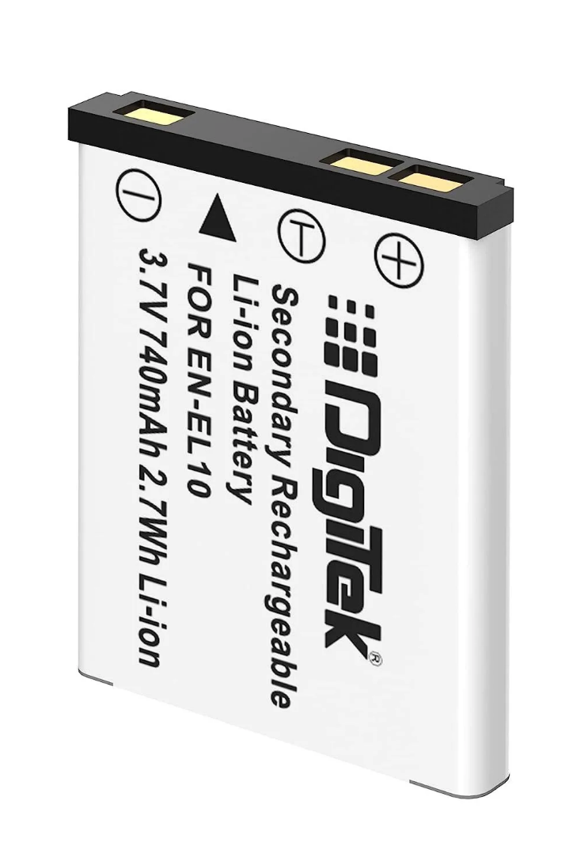
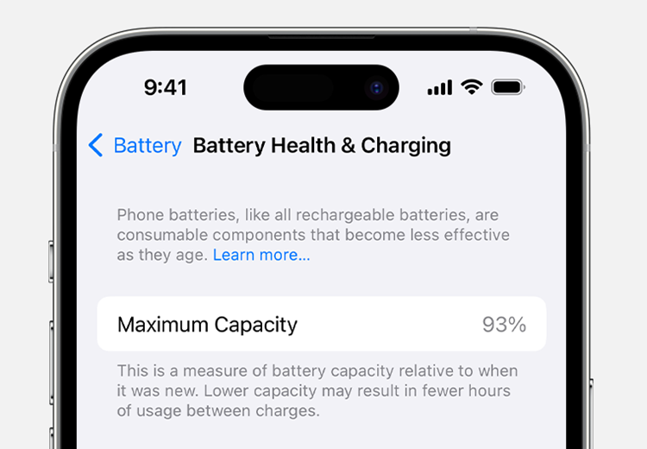
Notes:
I’m not going to claim that rechargeable lithium-ion batteries are a sinister form of planned obsolescence. But bear with me.
One of the benefits of the Phoebus lightbulbs was a brighter burn… consumers got brighter bulbs. They just happened to fail sooner than was necessary.
Lithium-ion battery-powered products are highly convenient and easy to use. There’s no ‘mobile’ in mobile phone without them.
But there’s a consequence.
As your iPhone “Battery Health” screen tells you… “Phone batteries, like all rechargeable batteries, are consumable components that become less effective as they age”.
Shall we “Learn more…”

Slide 7

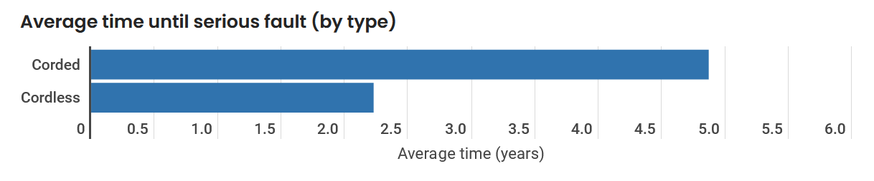
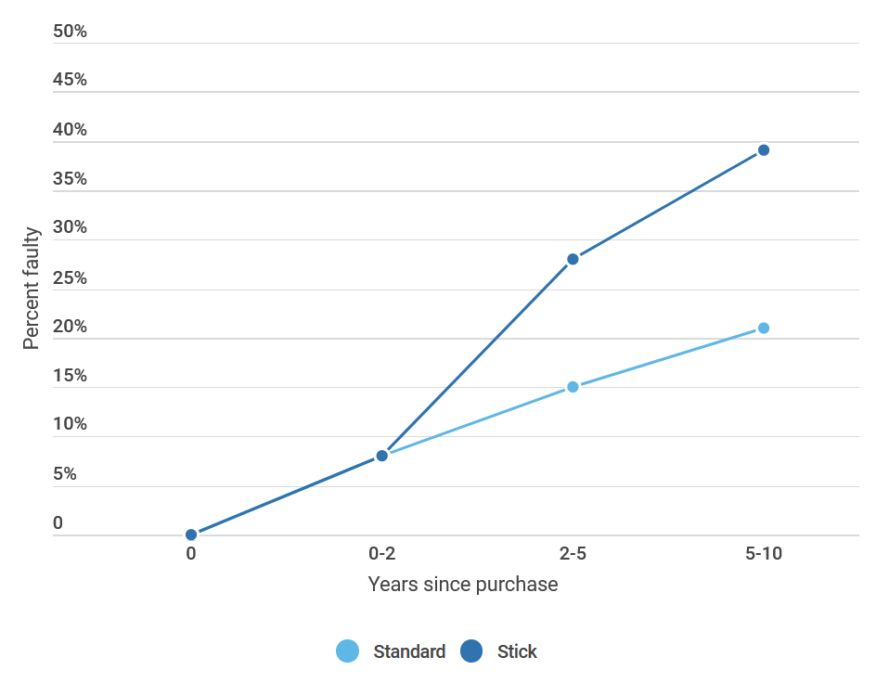

Notes:
At Consumer New Zealand in 2020, we published on a worrying trend of failures reported to us by owners of cordless vacuum cleaners.
These battery-powered stick models were becoming faulty sooner and more often than corded models.
So we delved deeper.
The average time to a serious fault appearing in a stick vac was 2.2 years, compared to almost 5 years in a corded model.
And the most common faults reported were significantly reduced run times, and a failure to charge.
This meant a lot of the reported faults were due to batteries wearing out. That became apparent to owners after a few years of use, and many owners deemed it to be a serious fault.
But this was surely no surprise to the manufacturers – it’s a well-known and documented result of the battery chemistry.
All lithium-ion batteries will wear out with use.
As Apple says… rechargeable batteries are consumable items.

Slide 8
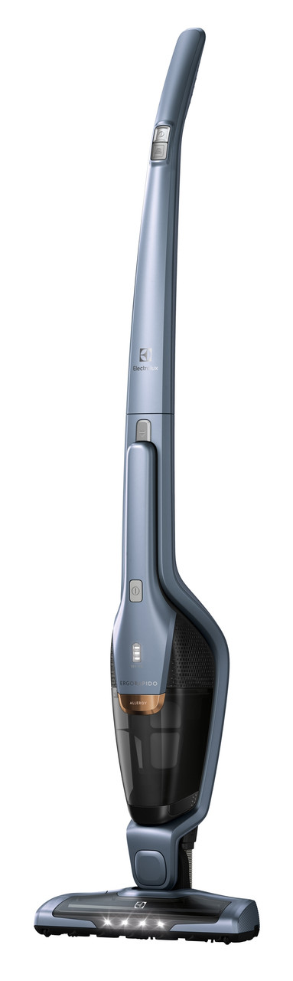
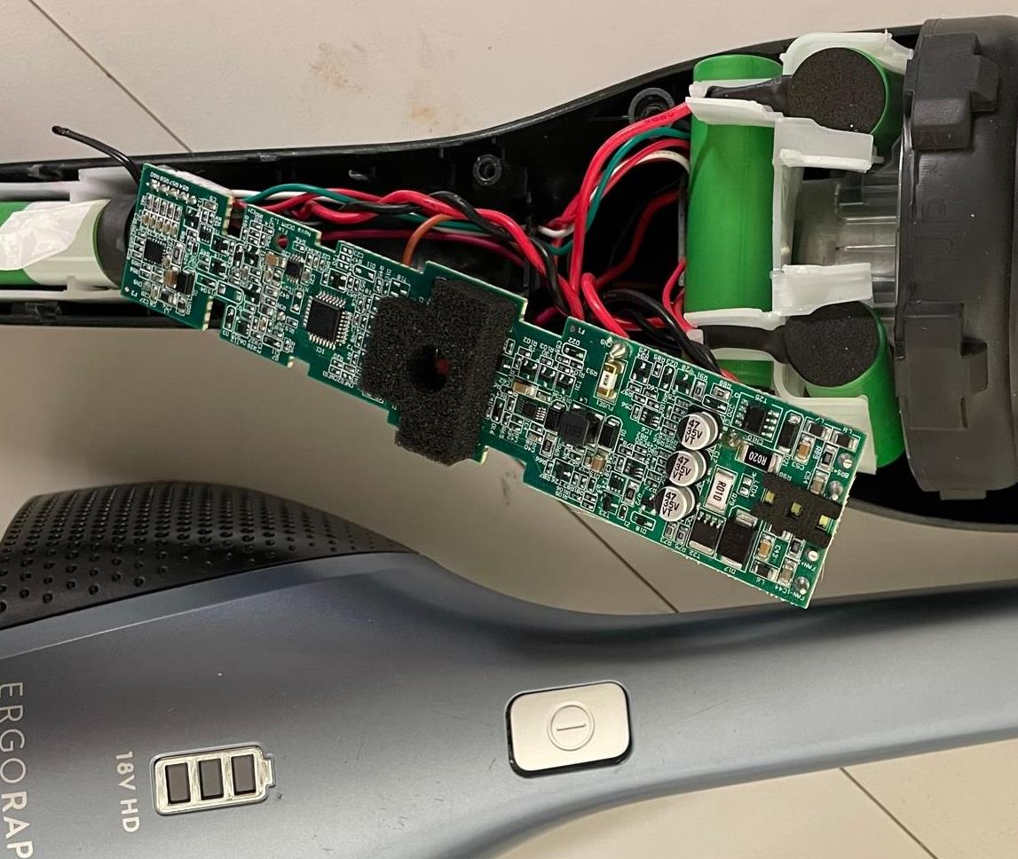
Notes:
The fault here isn’t with the battery.
It’s when the manufacturer makes that battery difficult, expensive, or even practically impossible to replace.
Like Electrolux did by soldering the batteries inside this stick vac.
When the consumable batteries die, the entire product becomes junk.

Slide 9
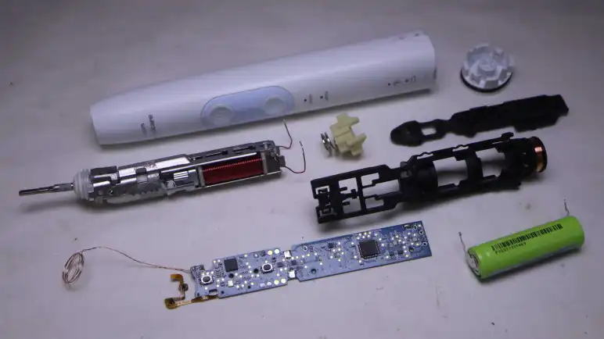

Notes:
It’s not just cordless vacuum cleaners.
Everywhere you find rechargeable batteries, you find examples of them being soldered or glued in.
It’s easy to justify. Product design and engineering is one big requirements trade-off…
The goal is to create a product with maximum appeal (and therefore sales), while minimising its cost.
During the process, repairability and durability usually lose out.

Slide 10
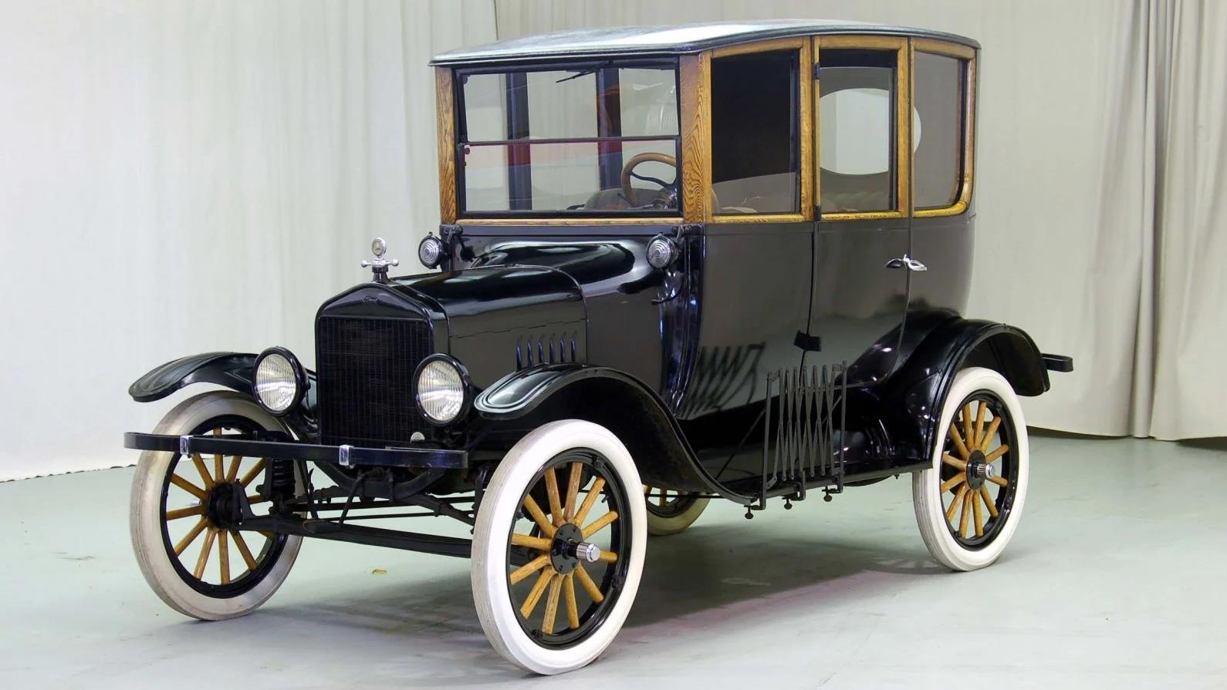
Notes:
To find the origin of the other side of planned obsolescence, let’s go back to the real the dawn of mass manufacturing.
Henry Ford produced the Model T from 1908 to 1927.
15 million were sold, with gradual improvement in the design over 19 years.
(Do you know which is the only car model to sell more than the T? – yep – it’s the Beetle. Adolf was a big fan of Henry Ford).
Ford wanted a car that was durable, efficient to manufacture, and cheap to buy and own.
For example, you could have “any colour as long as it is black” because black paint was cheap, durable and it dried faster.
That made production faster, and that made the Model T cheaper.
But the Model T didn’t last forever. In the mid-1920s, it’s sales declined quickly.

Slide 11
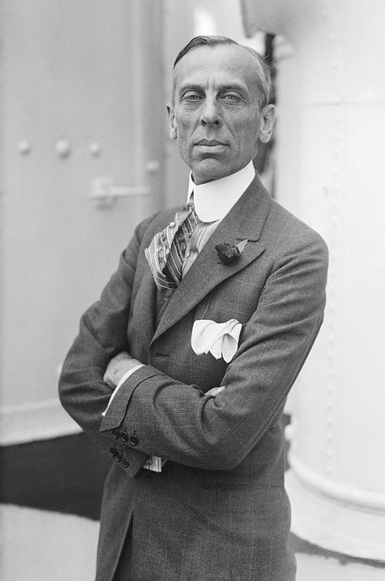

Alfred P Sloan President 1923-1937
“The changes in the new model should be so novel and attractive as to create demand . . . and a certain amount of dissatisfaction with past models.”
Notes:
Competition came from General Motors.
Its president, from 1923, was Alfred P Sloan. He couldn’t compete with Ford on cost, so he took a radically different approach.
At the start of the 1920s, the Model T outsold all General Motors models combined.
By 1927, Chevrolet (one of five General Motors brands) was outselling Ford and the Model T
Alfred Sloan is the father of planned psychological obsolescence.
He introduced annual styling changes to the cars, redefining the Chevrolet fleet each year with new colours, new shapes and better equipment.
The underlying car, its engineering, performance and durability, didn’t change much at all.
Sloan’s model year changes reduced the desire to own, maintain and cherish a car, by creating the impression it was out of date and unfashionable – just not as desirable as the new model.
And with the arrival of these exciting, new Chevrolet models, the Model T started to look very out of date. It’s sales fell off a cliff.
Ford replaced it with the Model A in 1928 – complete with it’s own annual styling changes.
Ford is the name we associate with the invention of mass manufacturing. But Sloan had at least as much influence on modern product manufacturing.

Slide 12
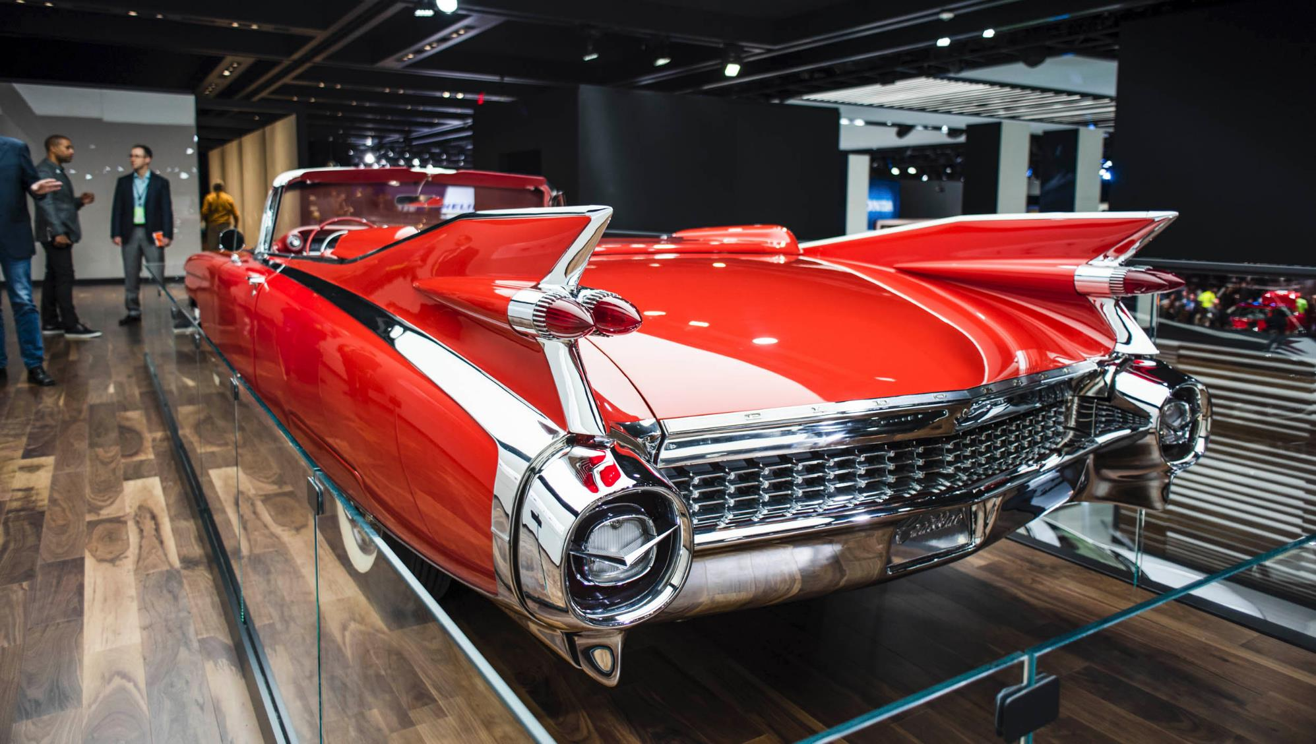
1959 Cadillac Eldorado Biarritz
Notes:
After WW2, Americans bought lots of cars. That meant, by the early 1950s, the market was saturated with used models, and new car sales plummeted.
What could manufacturers do to stimulate demand? Can you guess?
General Motors had proved planned psychological obsolescence worked – so manufacturers reintroduced it.
As before, General Motors led the way, this time with its luxury brand Cadillac.
During the 50s, Cadillacs transformed. They became bigger, heavier and ‘chrom-ier’ with each model year change.
The styling drew from jet aircraft design, with the most obvious change being the growth of fins.
The goal was the same as in the 1920s… to encourage customers to replace a perfectly good car.
Manufacturers used styling changes and intense marketing to create both desire and fear in consumers.
The desire was for a new and more attractive car. The fear was of being judged for sticking with last years unfashionable model.
As it had in the 1920s, it worked.

Slide 13
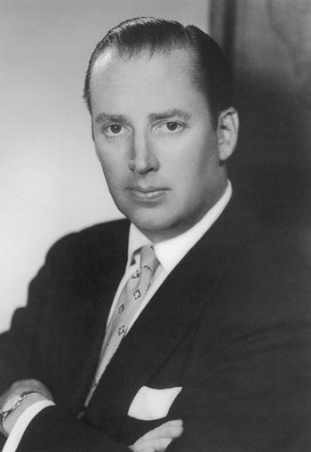

Brooks Stevens
1954
“Our whole economy is based on planned obsolescence. Instilling in the buyer the desire to own something a little newer, a little better, a little sooner than is necessary.”
Notes:
So much so, that psychological product obsolescence was a hot topic in mainstream media in the 1950s, with some sounding warning of its implications.
It’s champion was a product designer called Brooks Stevens.
He summed it up nicely with his quote.
The goal is to “Instil in the buyer the desire to own something a little newer, a little sooner than is necessary.”

Slide 14







11 2019
12 2020
13 2021
14 2022
15 2023
16 2024?
Notes:
Brooks Stevens would love how big tech has embraced the practice he championed.
I’ll use Apple as an example. They’re by no means the only culprit, but they are rather good at doing this obsolescence thing.
Here are the five most recent models of iPhone. Each one was released at a well-hyped launch event.
Every year we get another launch event and another iPhone generation.
Unlike the extravagant fins on 50’s Caddies, you’ll only see minor styling differences in these iPhones. The screen notch becoming a ‘dynamic island’ was touted as a big change. But styling isn’t how Apple makes its previous iPhone models seem obsolete. Obsolescence has become much more sophisticated.
The performance of the iPhone hasn’t made any leaps in any year since the iPhone 11 in 2019.
The owner of an outgoing model wouldn’t notice any real difference in using its replacement.
Yet Apple still gives us a new “must-have” model every year.
Each new model makes the previous one feel a little less desirable.

Slide 15




Notes:
Apple doesn’t hide its product obsolescence. It actually defines when its products become obsolete. That’s 7 years after they are discontinued from sale.
At that point, Apple stops supplying parts and hardware support for them.
Realistically, its products become unsupported after just 5 years, when it deems them “vintage”.
At that point Apple only supports them if it’s convenient for it to do so, or local laws demand it.
My iPhone 12 Pro was discontinued in October 2021, when the iPhone 13 replaced it.
That was just a year after this model was launched.
According to Apple, my phone will be vintage in less than 18 months.
At which point it’ll be just 6 years old (and no doubt working just fine as it is today).
When its lithium-ion battery eventually fails (and it will, it’s currently at 85% capacity), Apple won’t want to know.

Slide 16
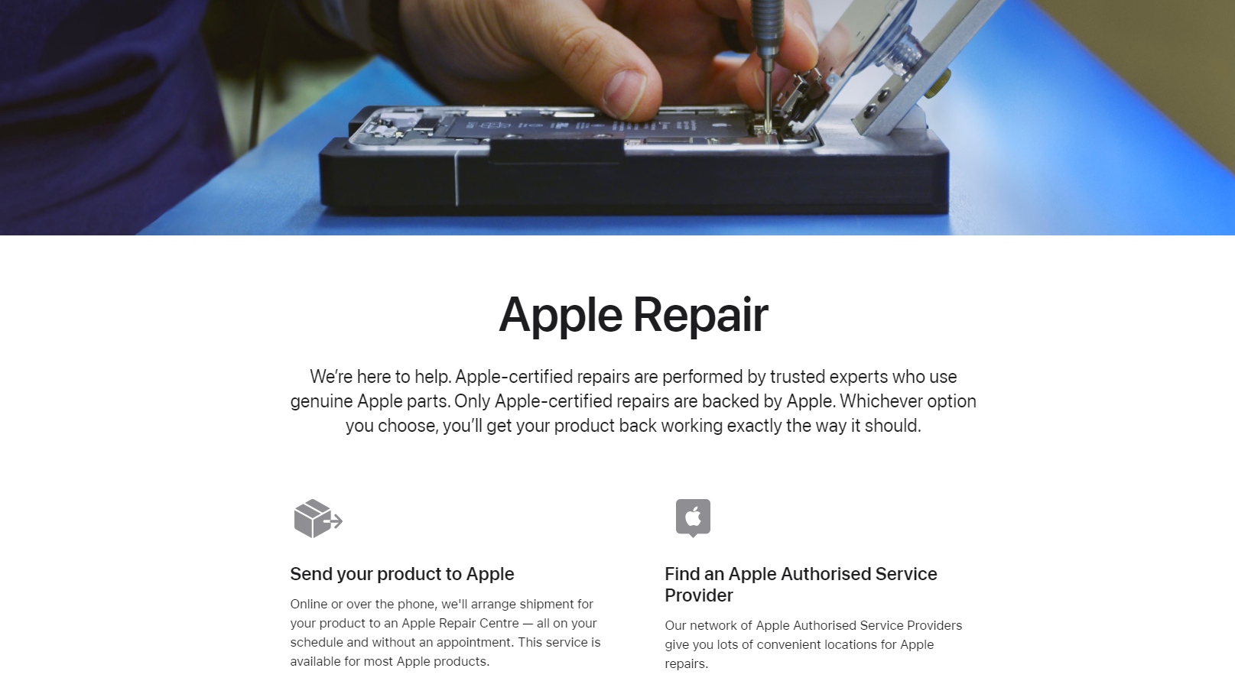
Notes:
Until it deems its products vintage, or obsolete, Apple makes a big deal about its repair programme.
That’s because there’s a lot of profit in a manufacturer controlling repair.
Apple would like us to have its Authorised repairer fit an Authorised battery.
It’ll tell me it’s not safe to use an unofficial battery, and I definitely shouldn’t try to replace it myself.
It’ll scare me that I can’t trust an independent repairer, as they’re likely to steal the personal data on my phone.
It also has a habit of using software locks to prevent unauthorised repairs from working properly.
For example, if I fit an unofficial screen it’s unlikely the biometric IDs, like Face ID, will work.
And of course, Apple has glued the battery into the phone, making it difficult and expensive to replace.

Slide 17

Indice de réparabilité
Repairability score 0-10
Mandatory 2021 (tech, appliances, garden)
Displayed with price
Defined method, self-calculated
Notes:
My iPhone 12 Pro scores a mediocre 6 out of 10 for repairability.
That’s according to the French repair index – mandatory there since 2021.
In this, manufacturers have to calculate the repairability of their products, based on a defined and published scoring system.
Then, the score has to be displayed at the point of sale with the price.
The index basically tracks how well a manufacturer implements repairability and supports a product throughout its life.
It’s a way to provide us with better information before we buy, so we can reward brands that support their products.
Since this index was launched, there’s evidence it’s caused Apple, and others, to improve the repairability of their products.

Slide 18
Notes:
We’ve moved on from the blunt tools of product obsolescence like reducing lightbulb life, or whacking fins onto cars.
Some things haven’t changed. The Phoebus cartel set out to profit by selling more lightbulbs. Chevrolet sold more cars. Manufacturers now still profit, primarily, from selling more new products.
The Kmart mixer went to landfill because it’s the most profitable model for Kmart. And there’s no legislation stopping them.
Manufacturers like Apple, though, have embraced product obsolescence and made it much more sophisticated.
Controlling product repair is the new battleground. It’s led us to question why its so difficult repair stuff.

Slide 19
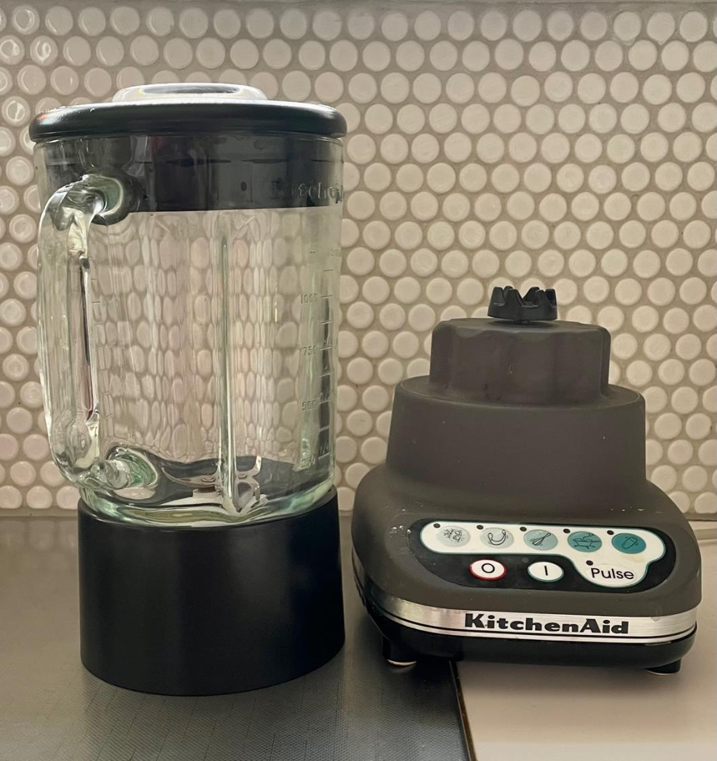

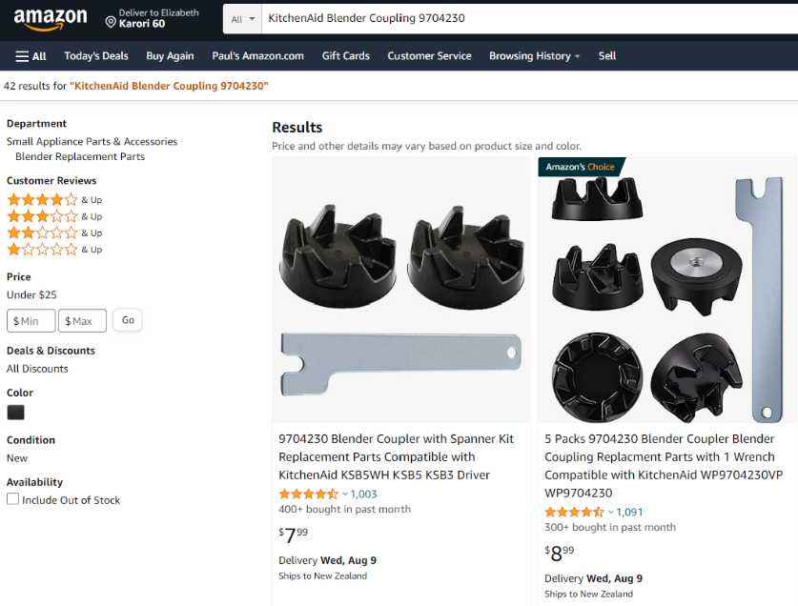
Notes:
Making products more repairable doesn’t need to be difficult, or costly.
Here’s a 20 year old blender.
If it jams and the motor burns out, or the drive fails, it’s a major fault that would probably be too difficult or expensive to fix.
So to prevent that, Kitchenaid added an easy to replace rubber coupling on top of the driveshaft.
If the blender stalls, the coupling fails.
It’s a 2 minute job to replace it – you can buy packs of couplings from Amazon for a few dollars.
This is good design. However, it needs the manufacturer to recognise that good design like this is valuable.
Our existing system doesn’t reward it.

Slide 20
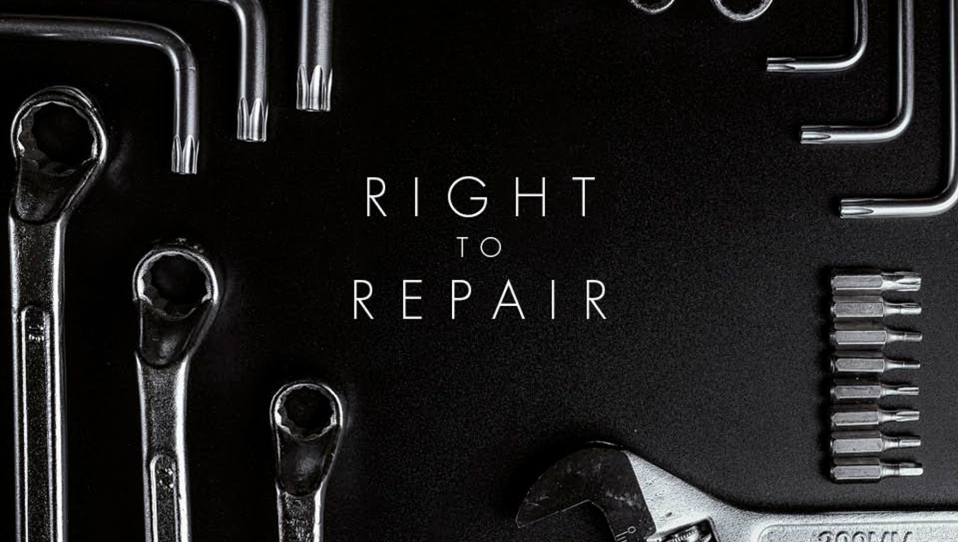
RIGHT TO REPAIR
We own the products we buy, so it’s up to us what we do with them.
If something breaks, it’s our right to choose to try to repair it (ourselves or using an expert of our choice).
Notes:
Frustration with unrepairable products has led to the right to repair movement.
It’s a simple demand… we should all be able to choose to repair the products we own.
It questions why a manufacturer should tell me what I can and can’t do to fix something.
Of course, we know it’s because manufacturers that want to sell more new products have a vested interest in preventing us fixing the existing ones.
Kmart does it by ignoring repair.
Apple does it by forcing us to only use authorised repairs.
The right to repair calls for legislation to fix this.
It would make practical improvements so repair is cheaper and easier,
It focusses on ensuring fair access to everything needed for repair for consumers and independent repairers.

Slide 21
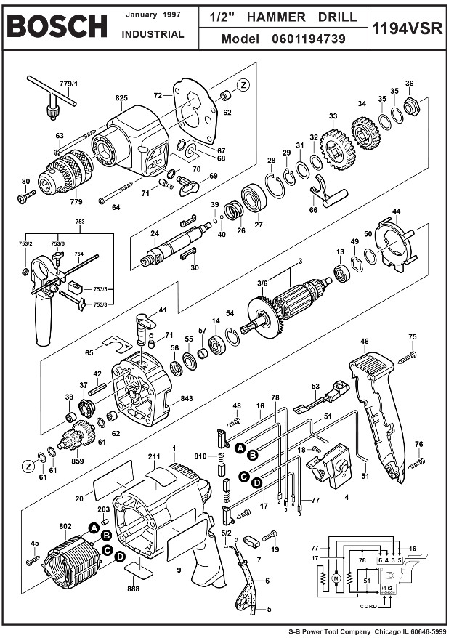

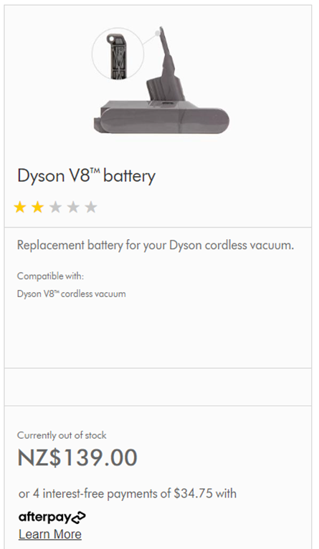
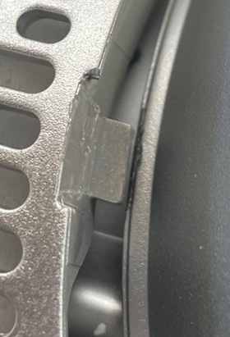
repair information
manuals, instructions, diagnostics, schematics, and software updates.
replacement parts
Parts, not assemblies, in stock at a reasonable cost and delivery time.
easy to disassemble
No glue or one-way snap fits, reusable fasteners, commonly available tools.
software barriers
No more ‘part pairing’ or using privacy and data security locks to prevent repair.
Notes:
In practice, that means…
Providing diagnostics, instructions and schematics gives us confidence a product can be repaired. Repair information helps us to understand what’s gone wrong and how it can be fixed, before we attempt to do it.
If replacement parts aren’t available, we usually can’t complete a repair. It’s important parts are really available (not just listed on a website, but “out of stock” or on a long lead time). And their cost needs to be reasonable – so repair compares favourably to a replacement product.
Making it easy to take a product apart makes it easy and cheap to fix. Fasteners should be reusable – glue and one-time snap-fits are cheap and easy to put together, but make a product difficult and costly to fix. If tools are needed, they should be ones we can all access, not some invented fastener standard with a driver unavailable outside the authorised network (such as the Pentalobe screw Apple invented for the iPhone, with its driver tool only available to its authorised repairers).
Right to repair also tackles software locks designed to prevent repair. ‘Part paring’ is common in tech devices and other software-controlled appliances, and prevents parts from two broken products being used to make one refurbished one.
This legislative task isn’t simple, as the right to repair needs it’s own legislation and amendments to other laws such as consumer and copyright.
But recently we’ve seen progress…

Slide 22
New York Digital Fair Repair Act passed December 2022
Followed by Minnesota, California and Oregon.
Are we reaching a tipping point?
No Bill is comprehensive, but together they include:
Electronics and appliances through B2C, B2B and B2G sales, backdated to July 2015.
Products costing >$100 must be supported for 7 years after sale.
Parts, tools, software and free-of-charge documentation made available to consumers and independent repairers.
Manufacturers can’t supply assemblies for “safety” reasons.
Manufacturers can’t limit the use of unauthorised parts.
Notes:
In December 2022, New York state passed a “Digital Fair Repair Act”.
It was flawed, thanks to some intense industry lobbying, but it was a start. Other states soon followed, each one making improvements. More are in the pipeline.
It’s one of the few topics that attracts bipartisan support – these bills have passed almost unanimously.
Taken as a whole, the US states are making great progress to a comprehensive right to repair.
The state laws cover most electronics and appliances, sold to consumers, businesses and government. Some backdated the requirements to include products already bought.
The California legislation defined a length of time a product must be supported for repair – 7 years for products costing $100 or more.
They all force manufacturers to share information, tools and parts beyond their own authorised repair networks, to independent repairers and consumers at a fair price (with no charge allowed for repair documentation).
And they attempt to close some of the loopholes manufacturers use to prevent repair, like supplying only expensive assemblies in the name of “safety” or voiding a warranty after an unauthorised repair.

Slide 23

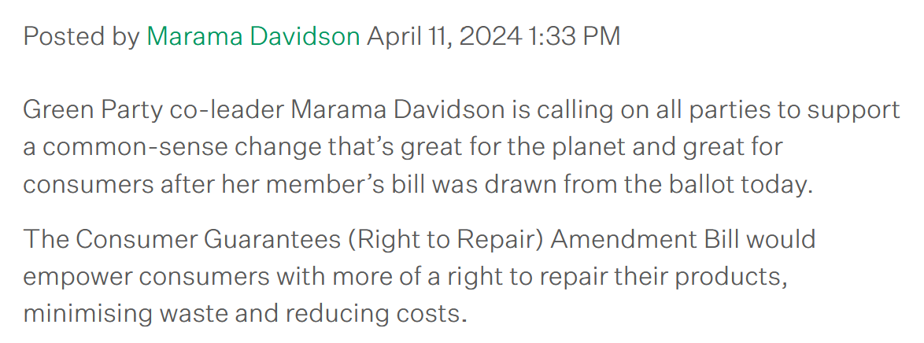
Notes:
What about closer to home?
Last month a Bill put forward by the Greens was drawn from the Members ballot.
The Consumer Guarantees (Right to Repair) Amendment Bill aims to make changes to our Consumer Guarantees Act.
As right to repair legislation goes, it’s not perfect.
But it’s an opportunity to show support for our right to repair to government.
If the bill gets enough cross-party support to pass it’s first reading in July, it goes to Select Committee for debate.
That would mean our right to repair will be a topic being discussed in government and we will all have a chance to submit our hopes and dreams for it.
We can show government that there is a real demand for change.
I’d urge everyone who cares to contact their local MP in the next month and show their support for the right to repair Bill.

Slide 24
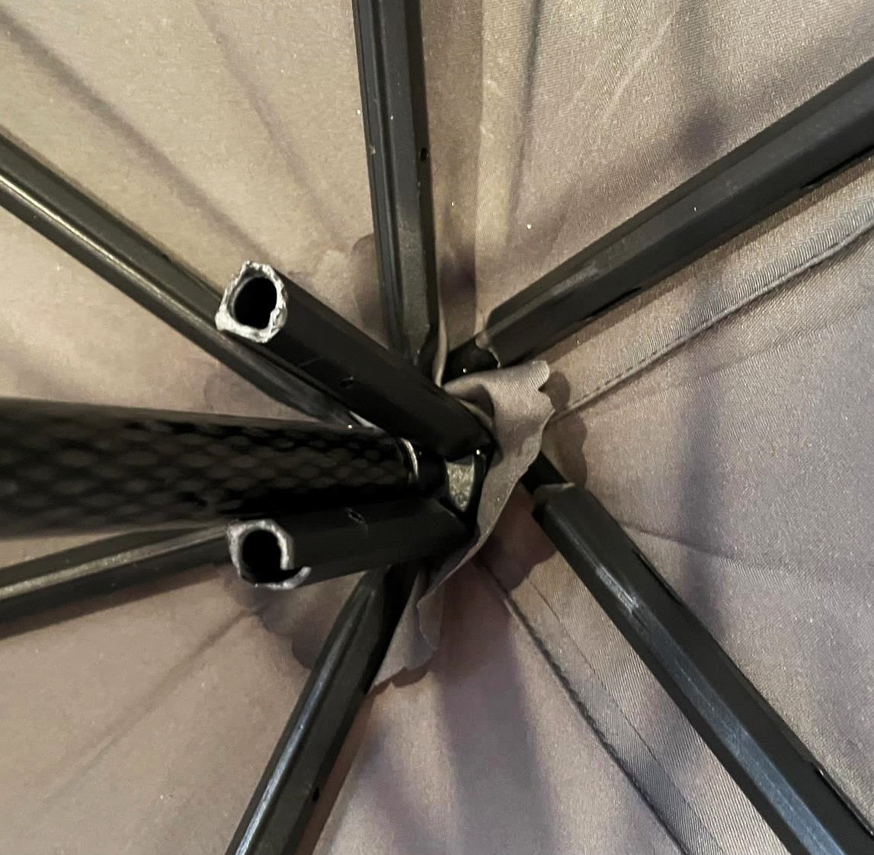


Notes:
Will right to repair legislation be enough?
Probably not. It is one piece of a much more complicated puzzle.
The end goal is to create a system where manufacturers see value in supporting their products.
Those that don’t (Kmart?) are forced to do the minimum by legislation, like meeting the right to repair.
Did anyone (apart from me) walk here yesterday under a Blunt umbrella?
They are a local brand that built their product and business around repair.
I think they’re a good example of where we could get to.
I recently had a Blunt blow apart on a typical Wellington day.
If this was most umbrellas, it would go into the bin.

Slide 25
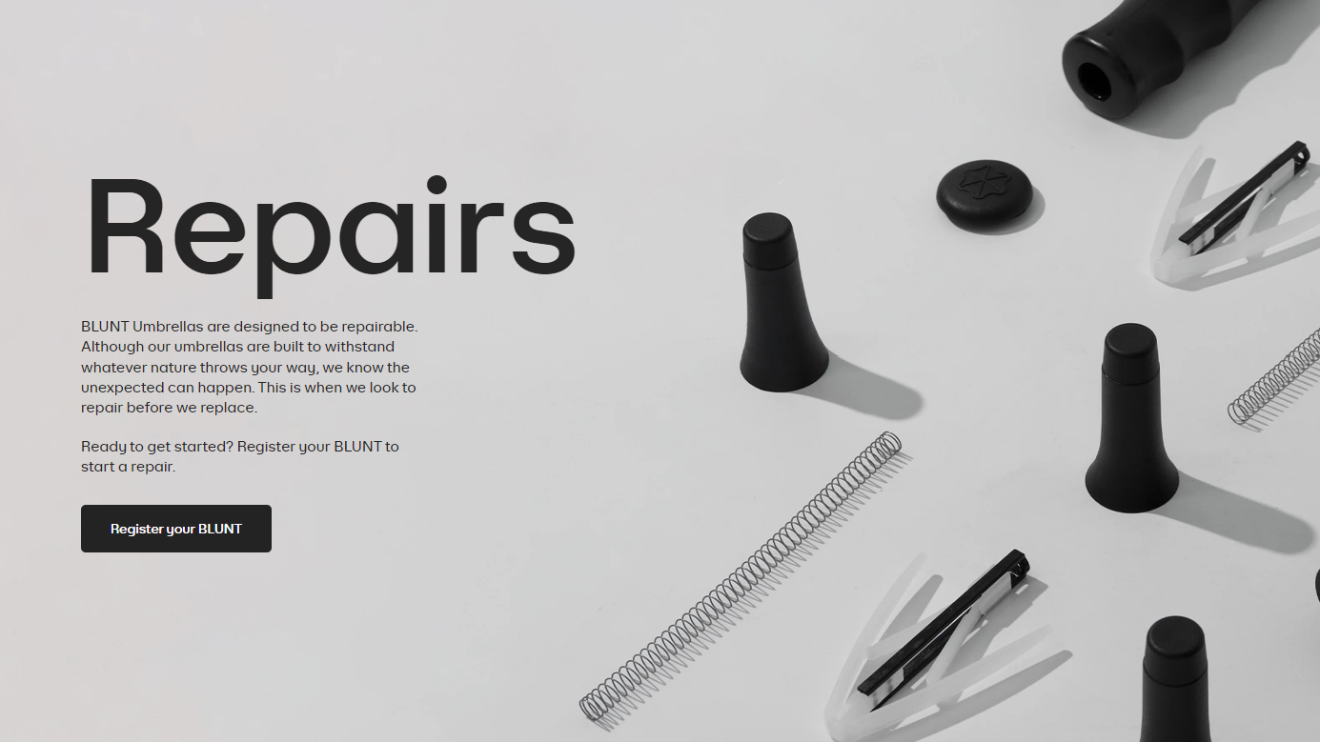

Notes:
But Blunt sent me the parts I needed, and I followed a repair video on the website.
The repair took about 30 minutes, needed no skill and just a pair of pliers.
Companies like this show there is a way to be profitable and support products long after the original sale.
But they are exceptions.
Most see repair as an additional cost of business they can’t justify. They don’t see the value in repairable products.
We need to support producers like Blunt, and encourage more of them, to show that there is another path.

Slide 26
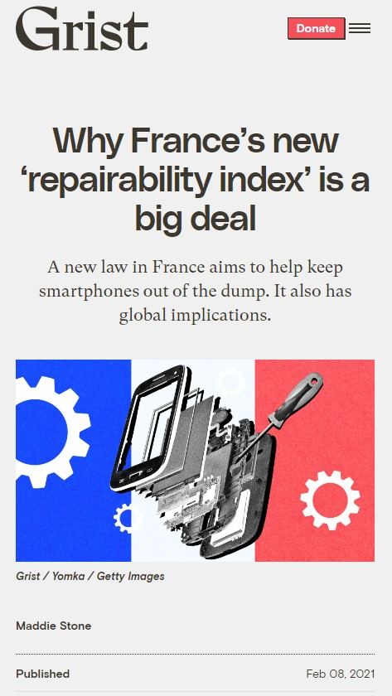
“… the moment something becomes a requirement, it’s no longer a problem for a manufacturer – they just have to deal with it.
So, some manufacturers choosing to make products more repairable will motivate others to improve their practices, for fear of missing out.”
Ugo Vallauri, cofounder of therestartproject.org
Notes:
Remember that repair score for my iPhone… 6 out of 10?
The French repair index has been seen as a good step forward – though not perfect.
The Restart Project, a repair advocacy organisation in London, summed up its potential.
Currently, manufacturers see repair as a problem – they don’t need to do it, so it’s easier to ignore it.
But when repair becomes a requirement, it can’t be ignored, and it becomes ‘business as usual’.
But they also suggested that it can do much more.
It pointed out that when some manufacturers take a risk, choose to compete on repair and show demand for it, others will follow for fear of missing out.
It suggests that mandatory or voluntary scoring and labelling of repairability could be a way to make repair a profitable part of a business.
Perhaps we could see some retailers assessing and labelling the products they sell. In Europe, mobile service providers do this for phones.

Slide 27
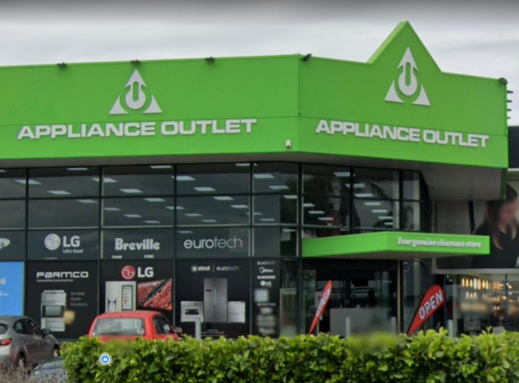


Notes:
Let’s return to where we started. But not quite peering into Spicer landfill.
Not all of the mixers in the tracking investigation got thrown away.
The Breville mixer ended its journey at Appliance Outlet in Auckland.
Appliance Outlet is the destination for many products that get returned to stores. Manufacturers like Breville pays them to dispose of its unwanted products.
Appliance Outlet choose to refurbish and resell as many of them as they can.
They are trying to do the right thing, but they wouldn’t do it if it didn’t pay – it’s a source of valuable revenue.
Breville, here, is the embodiment of the broken system.
Appliance Outlet is an example of how that system can be fixed.
I was shocked, but with hindsight not surprised, to find they also offer many ‘damaged box’ products that don’t even need refurbishing, but otherwise would still be scrapped. It seems our system is very efficient at making waste – entire products binned because a damaged box means they can’t be sold as new.

Slide 28
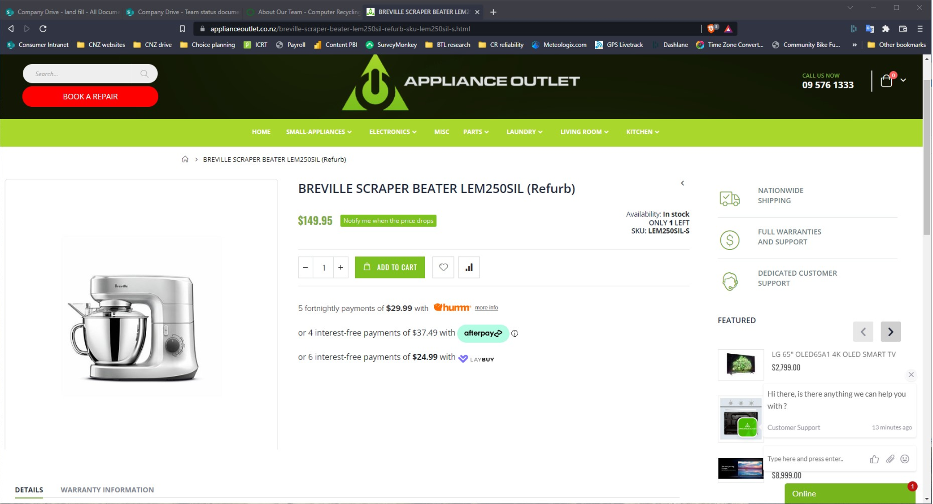
Notes:
I bought my Breville mixer for the second time.
This time, as a refurbished mixer, it cost $150, with a 12 months warranty.
Just a month or two earlier I’d bought it new for $450 – three times as much.
We need more businesses selling refurbished products like this.
That mixer investigation started because I wondered why I didn’t see many refurbished appliances being sold.
These businesses make buying refurbished goods as safe and appealing as buying new ones.
Customers get better quality products and the security of a warranty and Consumer Rights protections.
We could measure our success in fixing our broken system, by seeing more businesses like this appear and thrive.
The current system isn’t set up to help them. It’s the result of a century of product obsolescence, of making value all about selling new products.
There’s no one simple solution.
It’ll need a combination of legislation and all of us choosing to support repair and refurbishing. As consumers we need to demand durable, repairable products and show a desire to care for the stuff we own.

